Slide 1
Tutorial machine learning in solid mechanics
Task 2 – Hyperelasticity

Slide 2
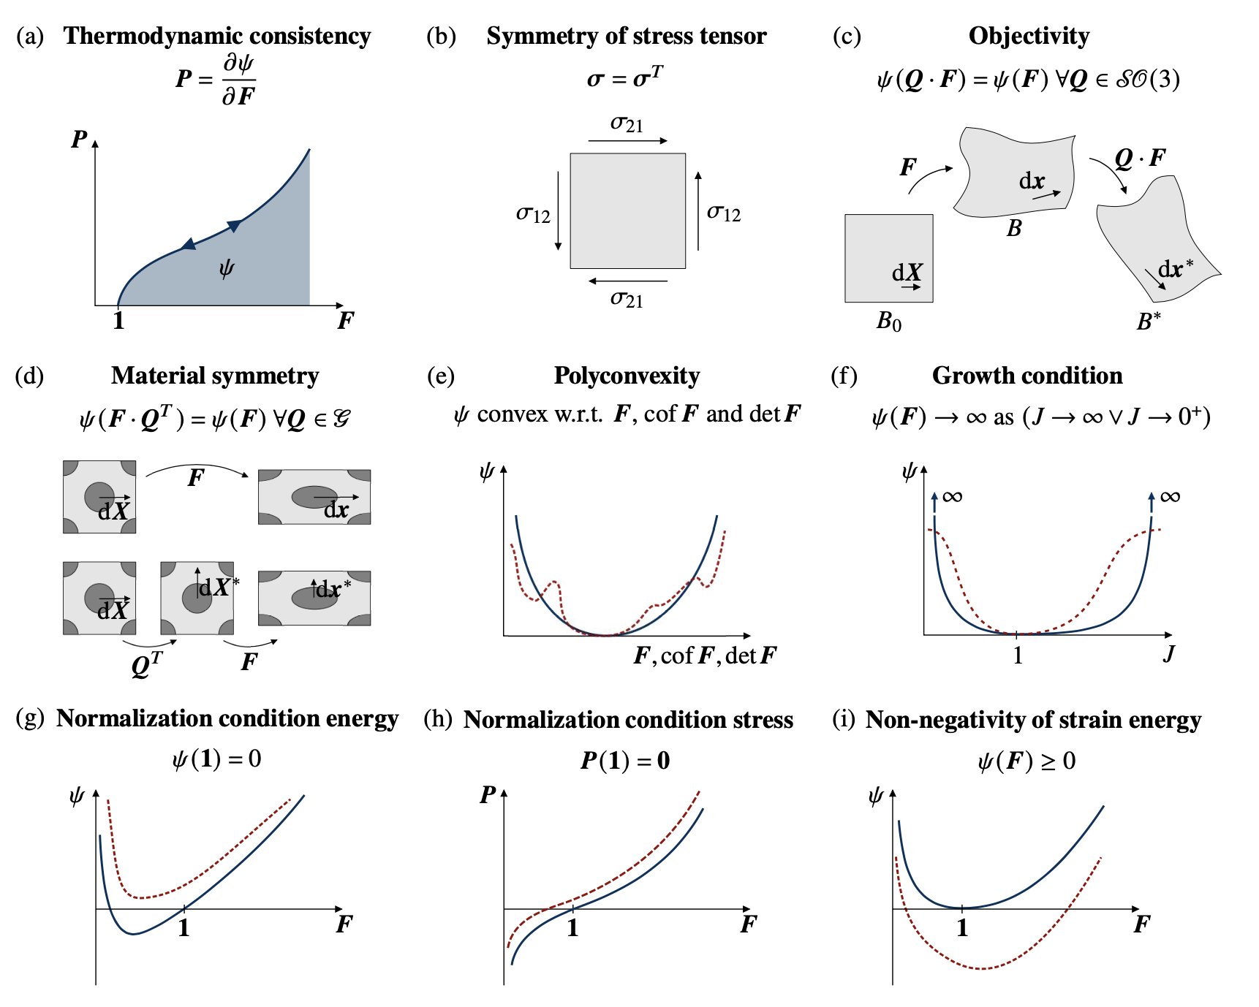
Embedding physics in ML-models
…
…
…
…
input layer
hidden layer
output layer

Slide 3
Embedding physics in ML-models
Physics
[1]
[1] https://doi.org/10.1016/j.jmps.2023.105363
…
…
…
…
input layer
hidden layer
output layer

Slide 4
Embedding physics in ML-models
Physics
[1]
…
…
…
…
input layer
hidden layer
output layer
[1] https://doi.org/10.1016/j.jmps.2023.105363

Slide 5
Embedding physics in ML-models
Physics
If we embedding physics in our ML-Models which impact has this on …
the size of the NN?
the amount of data?
the generalization behavior of the model?
inductive bias?
…
…
…
…
input layer
hidden layer
output layer

Slide 6
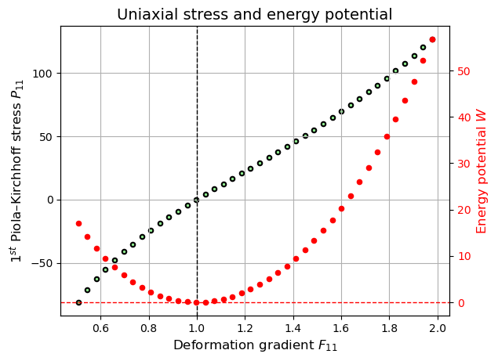
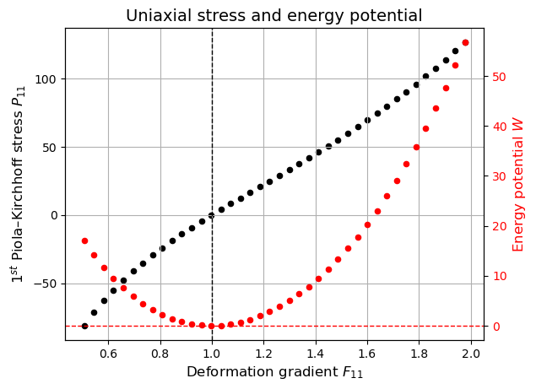
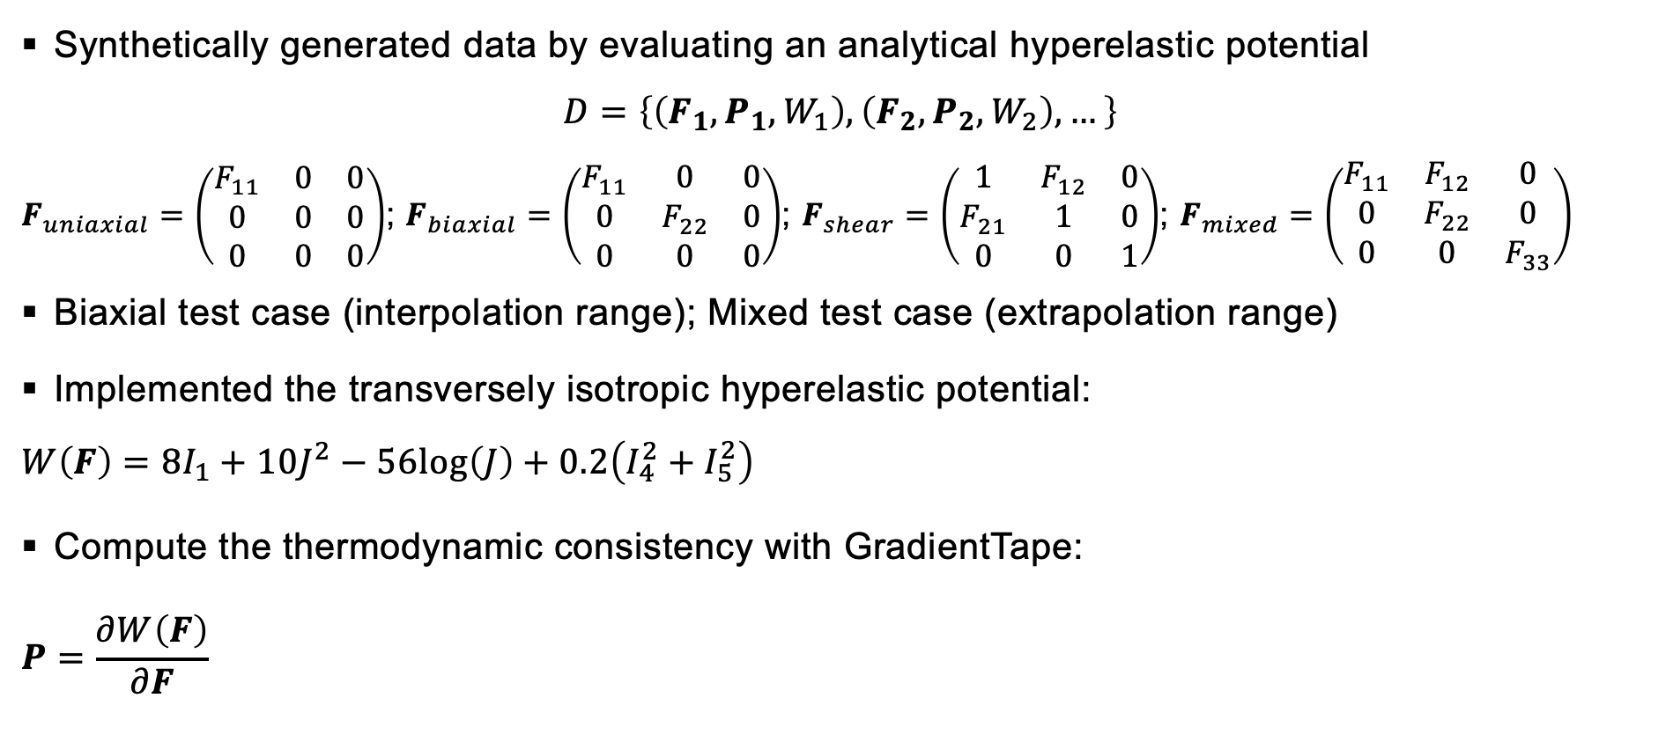
Data preparation
Synthetically generated data by evaluating an analytical hyperelastic potential
$$D=\left\{\left(F_{1}, P_{1}, W_{1}\right),\left(F_{2}, P_{2}, W_{2}\right), …\right\}$$
$F_{uniaxial}=\left(\begin{matrix}F_{11} & 0 & 0 \\ 0 & 0 & 0 \\ 0 & 0 & 0\end{matrix}\right)$; $F_{biaxial}=\left(\begin{matrix}F_{11} & 0 & 0 \\ 0 & F_{22} & 0 \\ 0 & 0 & 0\end{matrix}\right)$; $F_{shear}=\left(\begin{matrix}1 & F_{12} & 0 \\ F_{21} & 1 & 0 \\ 0 & 0 & 1\end{matrix}\right)$; $F_{mixed}=\left(\begin{matrix}F_{11} & F_{12} & 0 \\ 0 & F_{22} & 0 \\ 0 & 0 & F_{33}\end{matrix}\right)$
Biaxial test case (interpolation range); Mixed test case (extrapolation range)
Implemented the transversely isotropic hyperelastic potential:
$$W\left(F\right)=8I_{1}+10J^{2}−56log\left(J\right)+0.2\left(I_{4}^{2}+I_{5}^{2}\right)$$
Compute the thermodynamic consistency with GradientTape:
$$P=\frac{∂W\left(F\right)}{∂F}$$

Slide 7
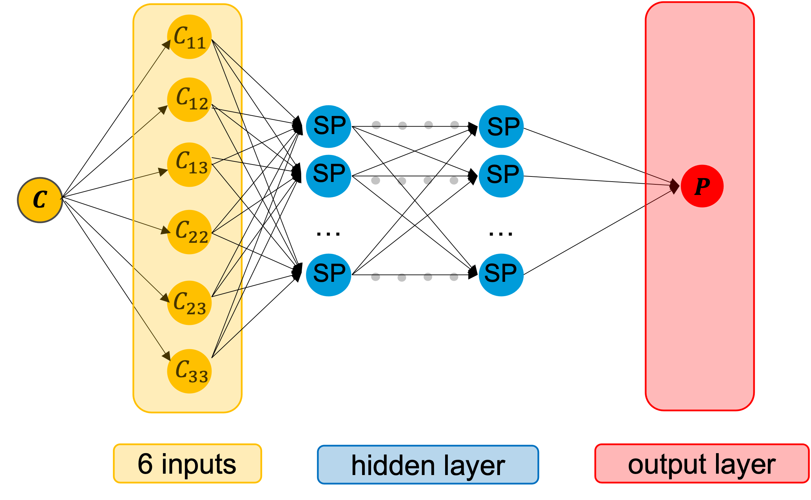
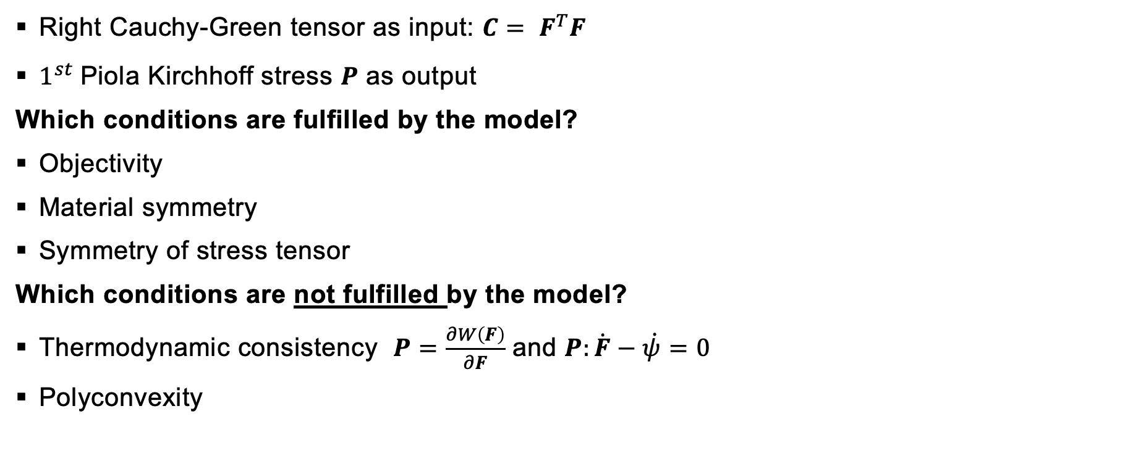
Neural network model – A naïve approach
Right Cauchy-Green tensor as input: $C= F^{T}F$
$1^{st}$Piola Kirchhoff stress $P$ as output
Which conditions are fulfilled by the model?
Objectivity
Material symmetry
Symmetry of stress tensor
Which conditions are not fulfilled by the model?
Thermodynamic consistency $P=\frac{∂W\left(F\right)}{∂F}$ and $P:\dot{F}−\dot{ψ}=0$
Polyconvexity

Slide 8
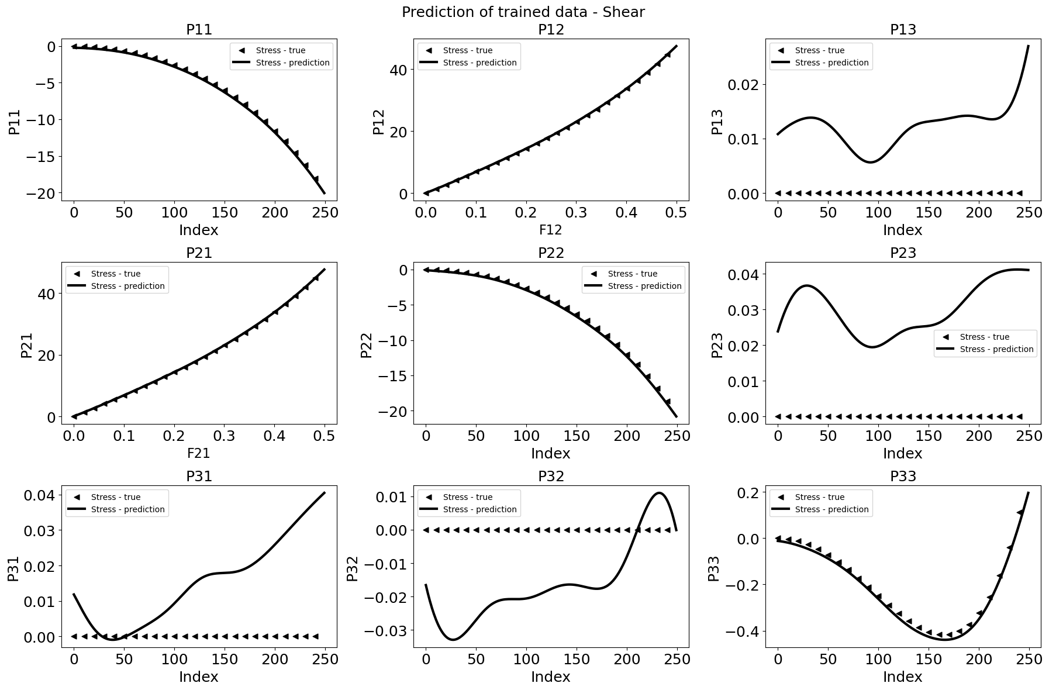
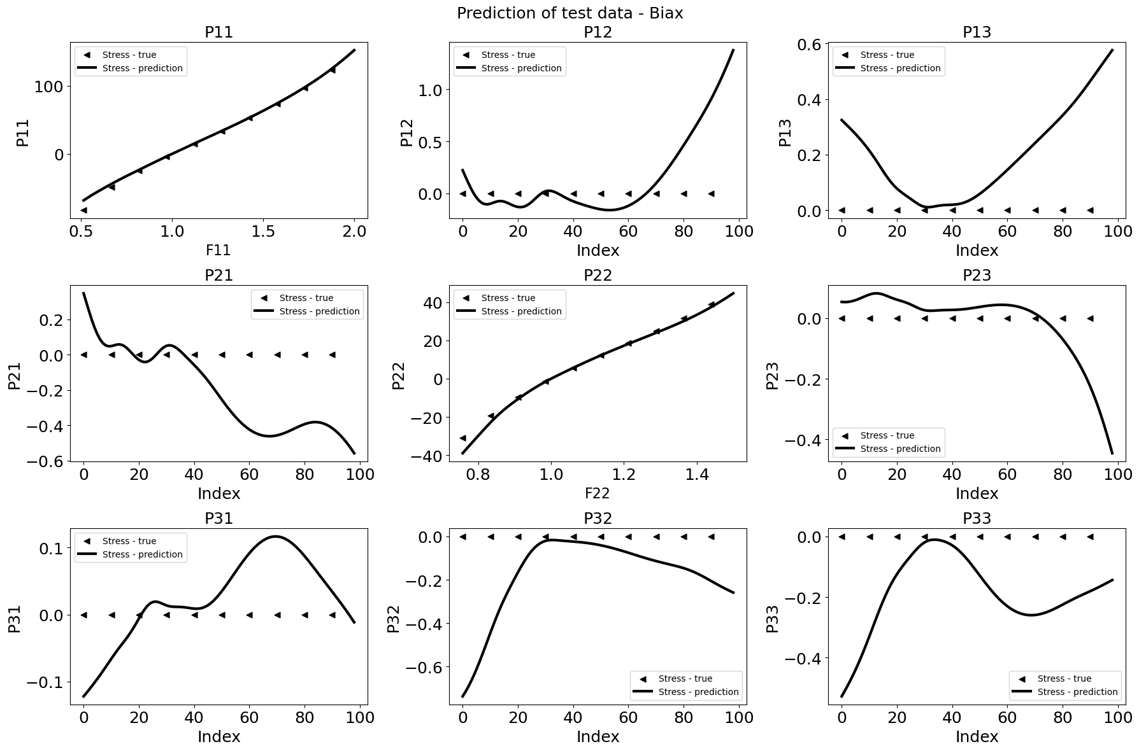
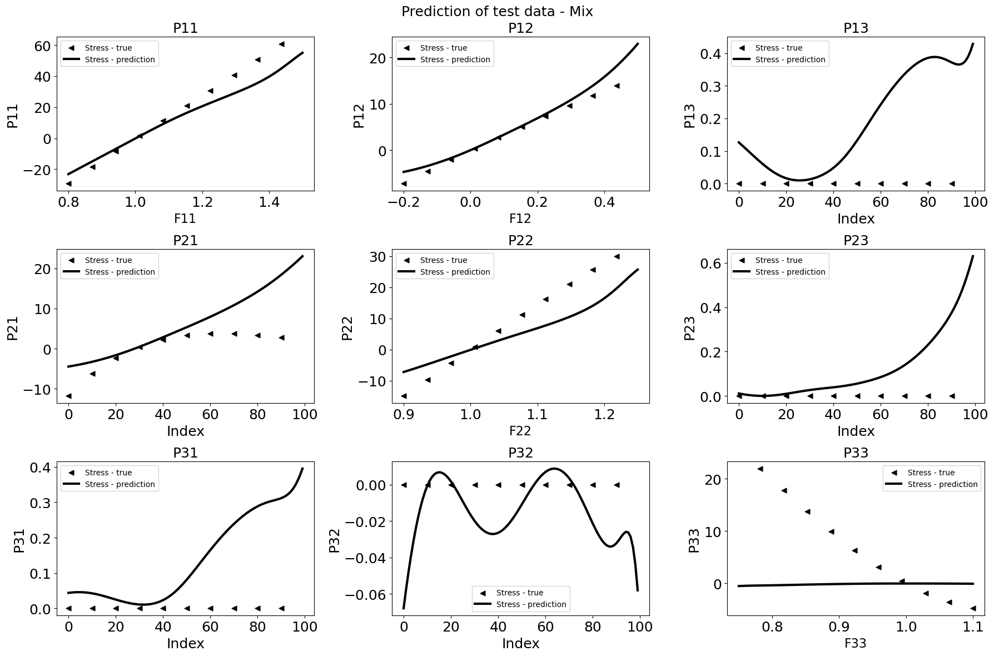
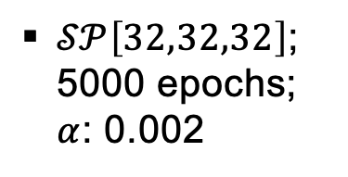
Neural network model – A naïve approach
$𝒮𝒫\left[32,32,32\right]$; 5000 epochs; $α$: 0.002

Slide 9
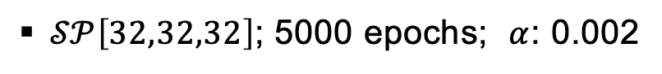
Neural network model – A naïve approach
$𝒮𝒫\left[32,32,32\right]$; 5000 epochs; $α$: 0.002
Able to interpolate data
Not able to extrapolate data
Model does not behave physically sensible, as among other things, the thermodynamic consistency is not fulfilled!
This means the “generalization” of the naïve model is not good.
We therefore need to find a new approach and try to fulfill the conditions

Slide 10
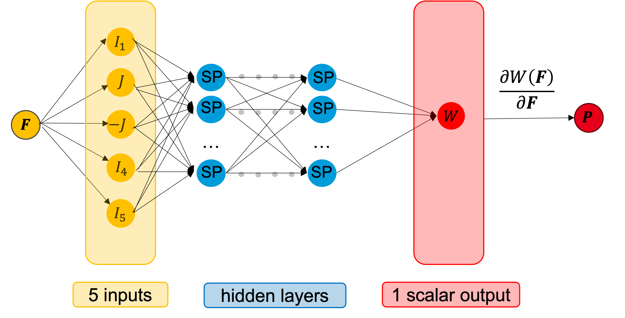
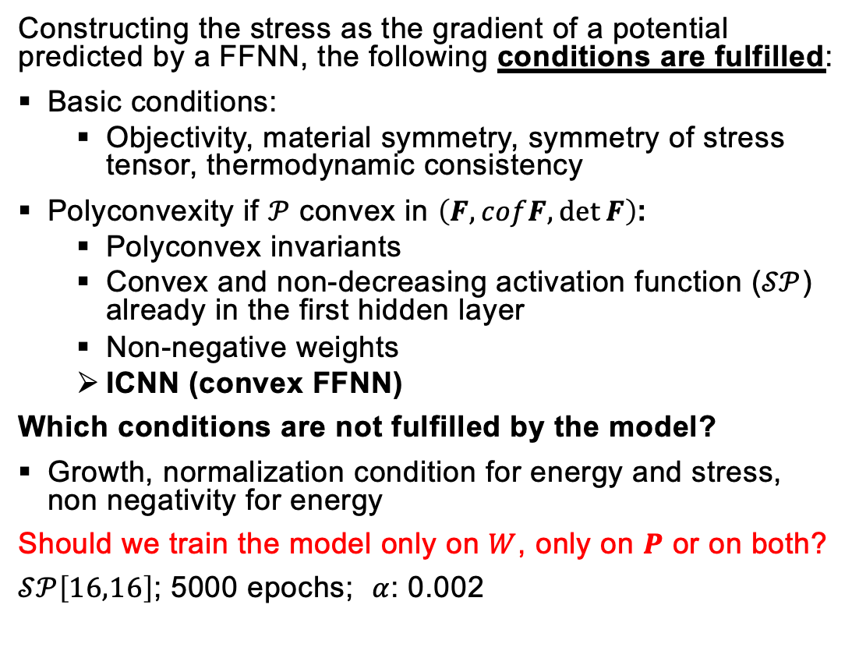
Physics-augmented neural network - Invariant-based PANN model
Constructing the stress as the gradient of a potential predicted by a FFNN, the following conditions are fulfilled:
Basic conditions:
Objectivity, material symmetry, symmetry of stress tensor, thermodynamic consistency
Polyconvexity if $𝒫$ convex in $\left(F, cofF,\det{F}\right)$:
Polyconvex invariants
Convex and non-decreasing activation function ($𝒮𝒫$) already in the first hidden layer
Non-negative weights
ICNN (convex FFNN)
Which conditions are not fulfilled by the model?
Growth, normalization condition for energy and stress, non negativity for energy
Should we train the model only on $W$, only on $P$ or on both?
$𝒮𝒫\left[16,16\right]$; 5000 epochs; $α$: 0.002

Slide 11
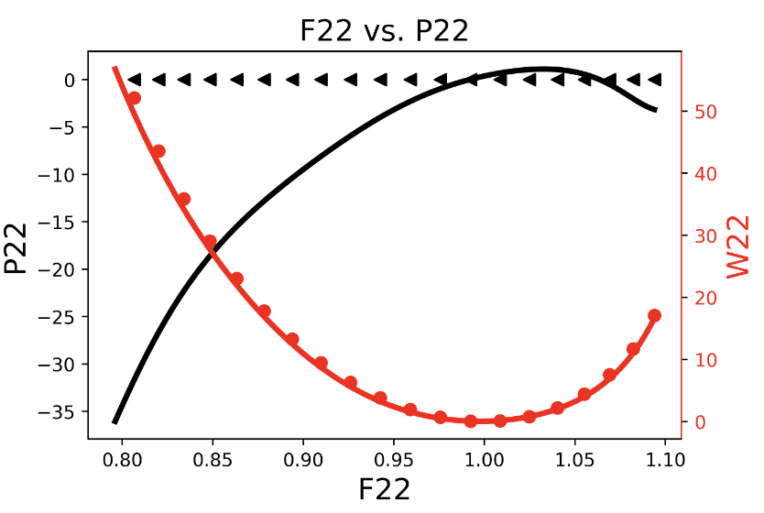
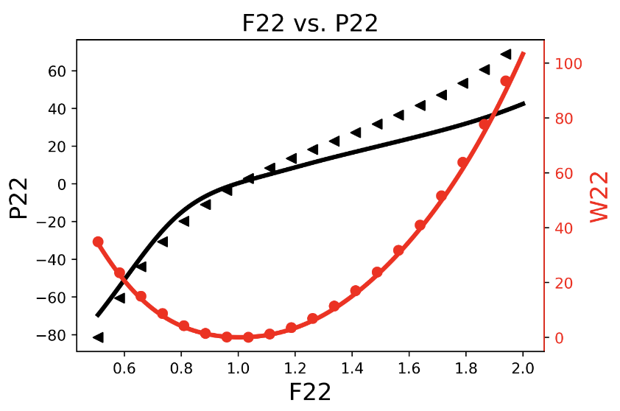
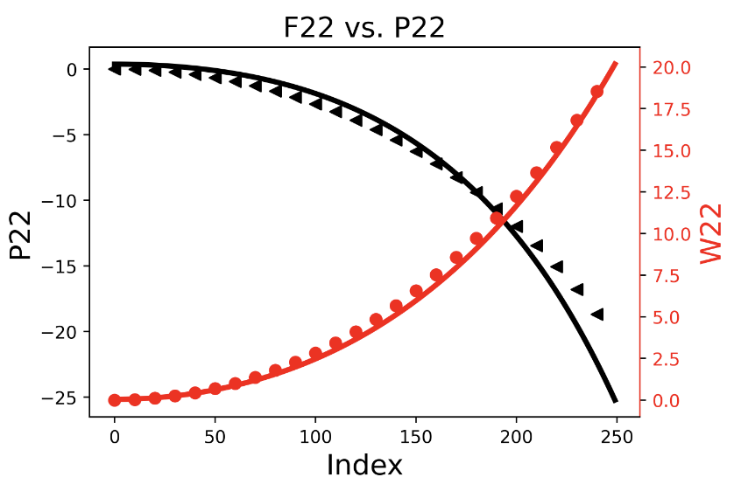
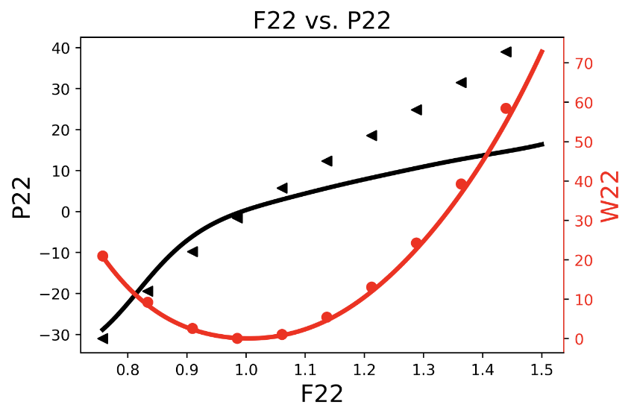
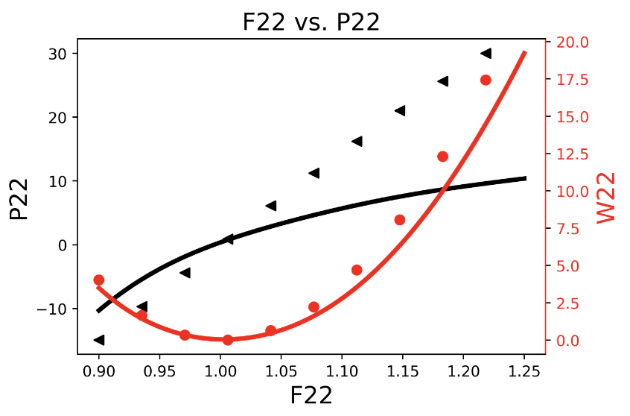
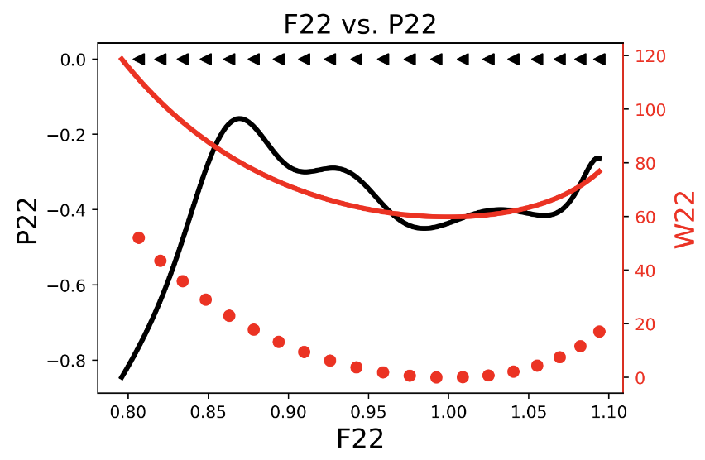
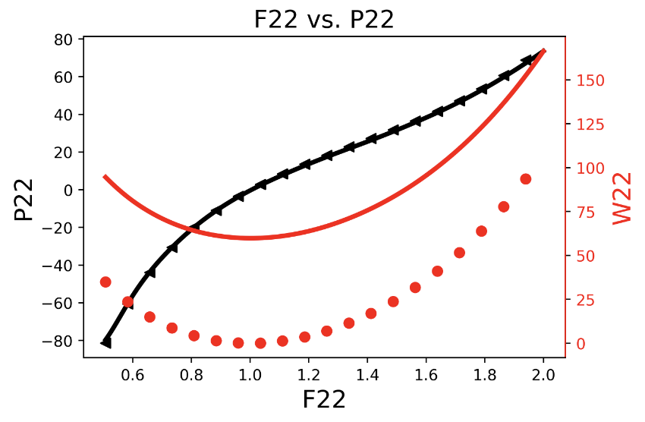
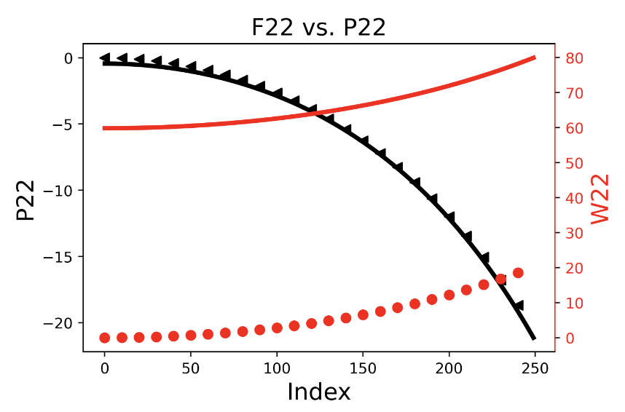
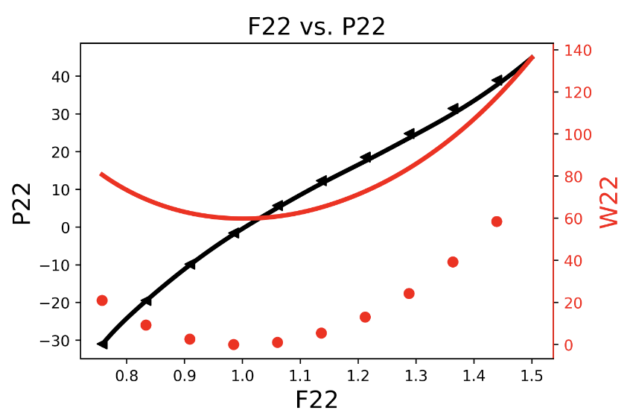
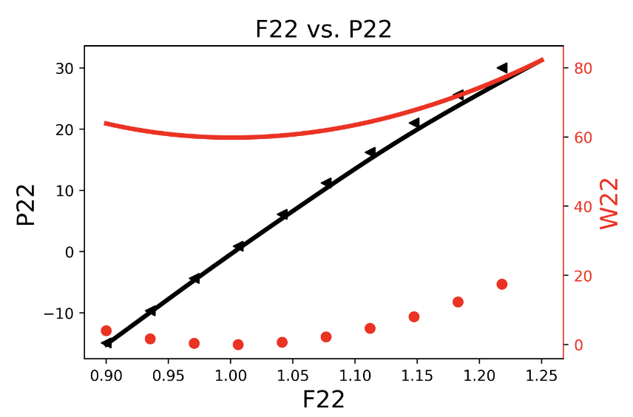
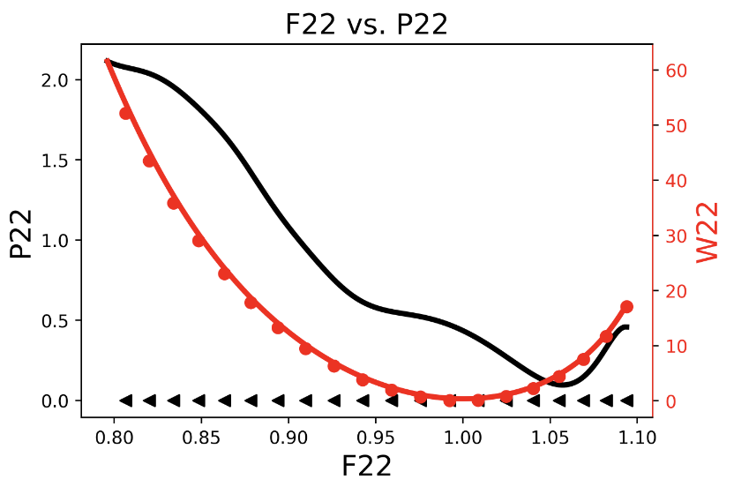
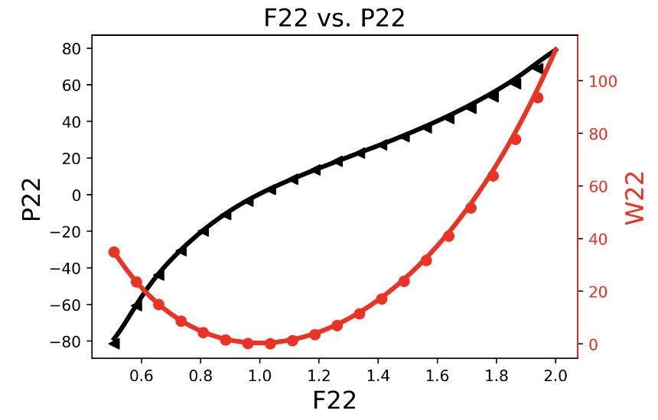
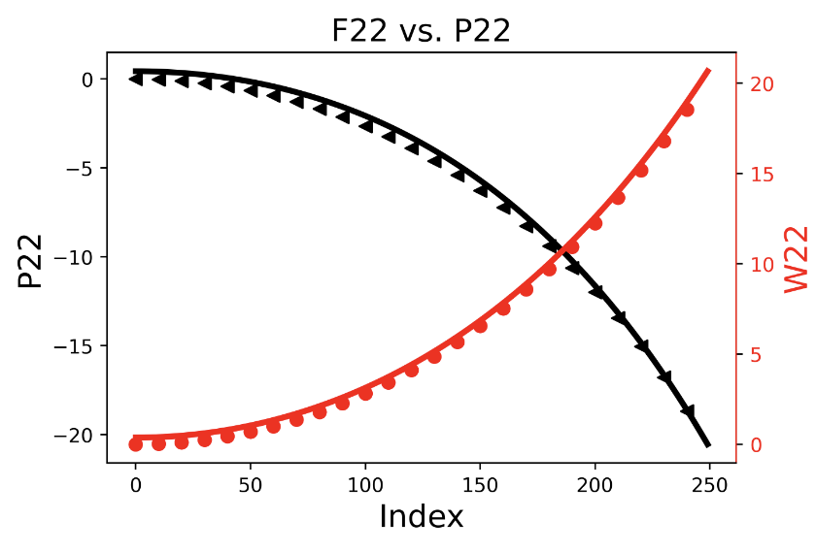
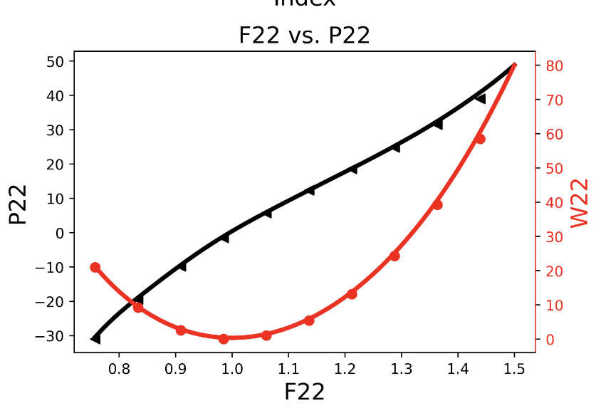
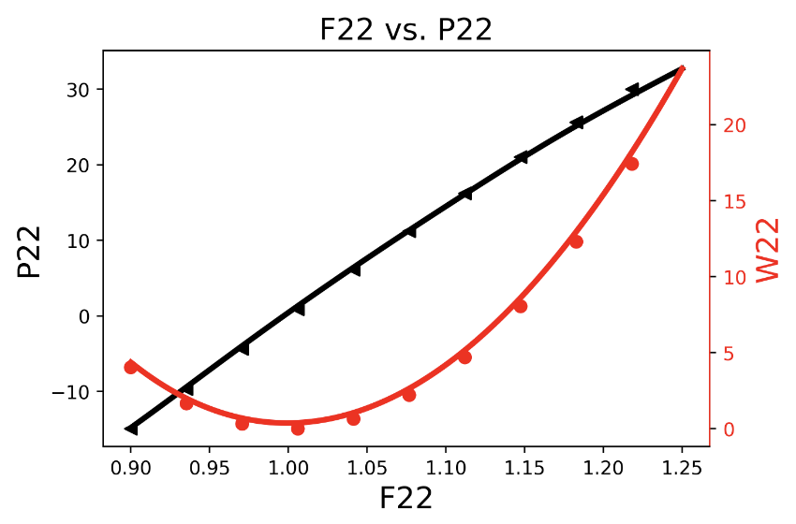
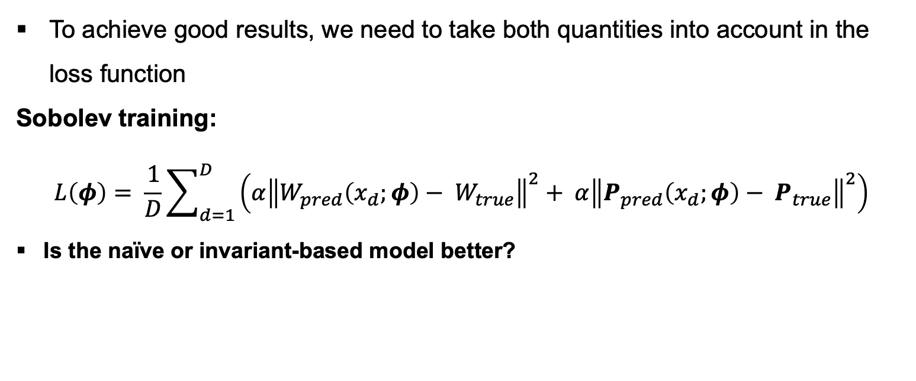
Influence of loss function on results
Uniaxial
Biaxial
Shear
Biaxial test
Mixed test
Train on W
To achieve good results, we need to take both quantities into account in the loss function
Sobolev training:
$$L\left(φ\right)= \frac{1}{D}\sum_{d=1}^{D}{\left(α{\left\|W_{pred}\left(x_{d};φ\right)− W_{true}\right\|}^{2}+ α{\left\|P_{pred}\left(x_{d};φ\right)− P_{true}\right\|}^{2}\right)}$$
Is the naïve or invariant-based model better?
Train on P
Train on both

Slide 12


Comparison between – Naïve and invariant-based model
$$𝒮𝒫\left[32,32,32\right]$$
$$𝒮𝒫\left[16,16\right]$$
PANN is able to …
interpolate the calibration data set
predict unseen load cases
with a much smaller NN size.
Generalization behavior increases the more physics is taken into account!

Slide 13
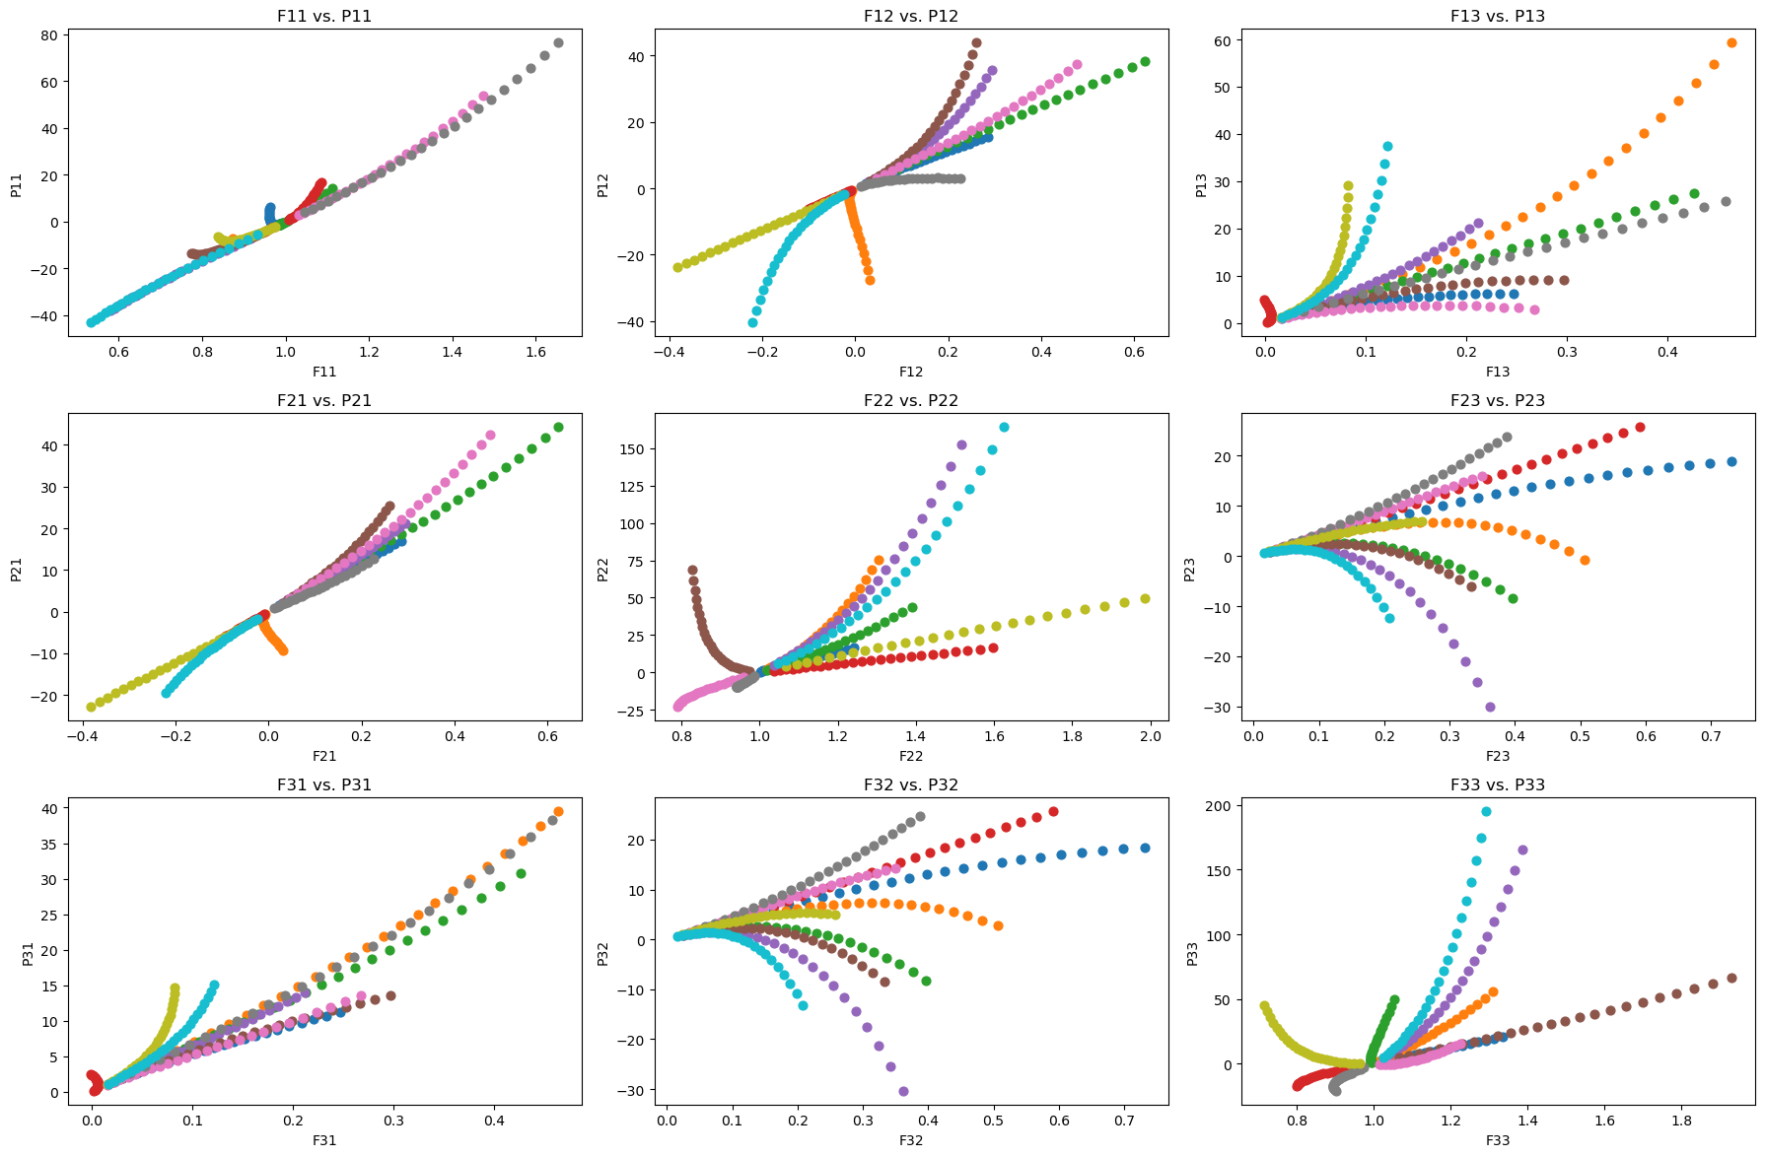
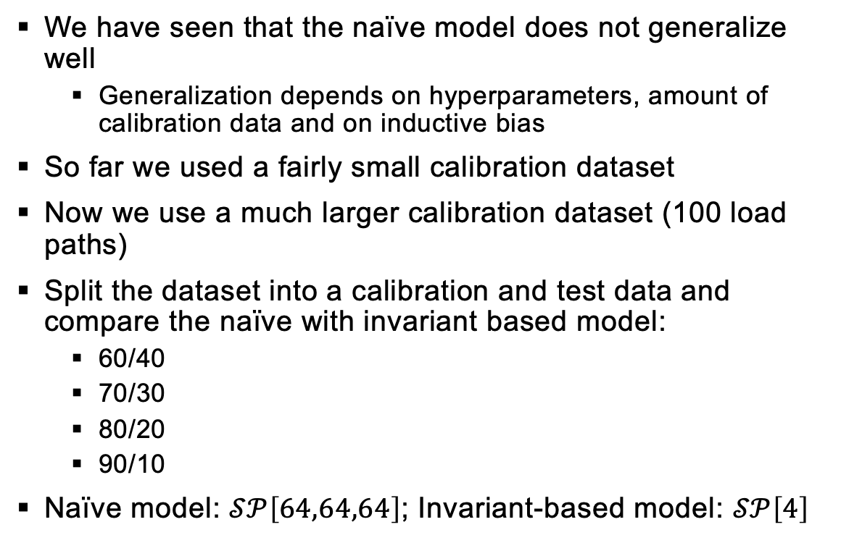
Concentric sampled deformation gradients – Generalization of NN’s
We have seen that the naïve model does not generalize well
Generalization depends on hyperparameters, amount of calibration data and on inductive bias
So far we used a fairly small calibration dataset
Now we use a much larger calibration dataset (100 load paths)
Split the dataset into a calibration and test data and compare the naïve with invariant based model:
60/40
70/30
80/20
90/10
Naïve model: $𝒮𝒫\left[64,64,64\right]$; Invariant-based model: $𝒮𝒫\left[4\right]$

Slide 14
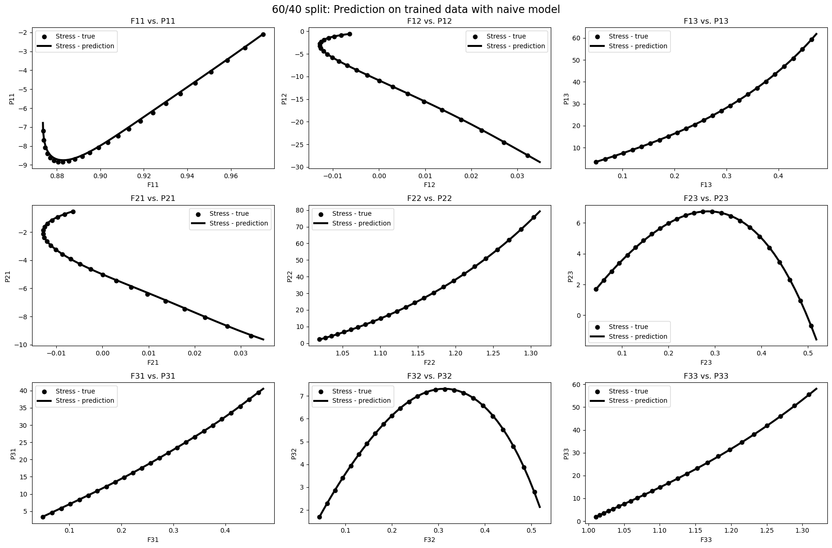
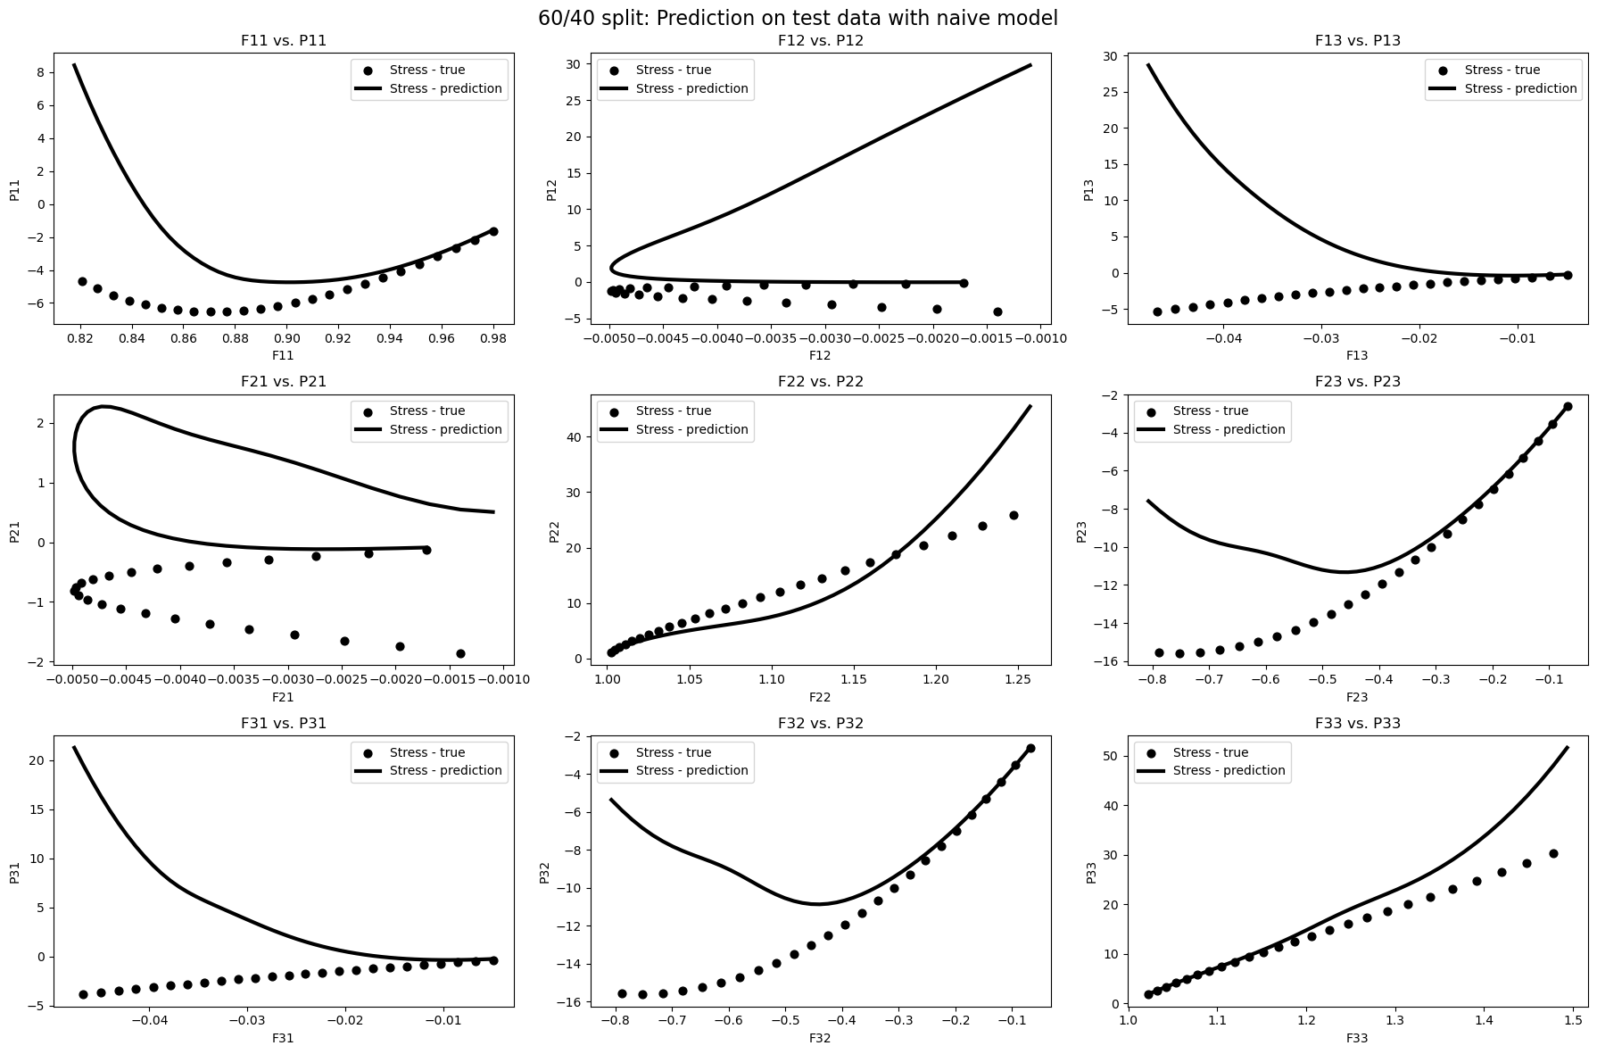
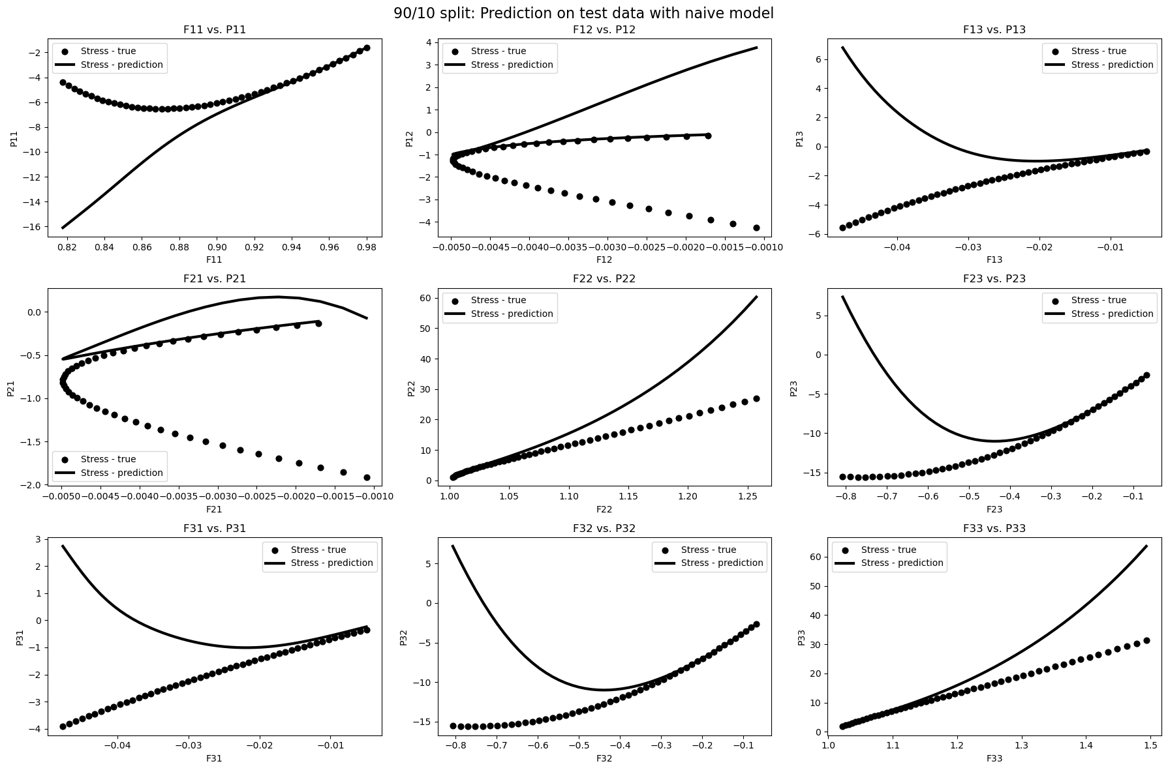
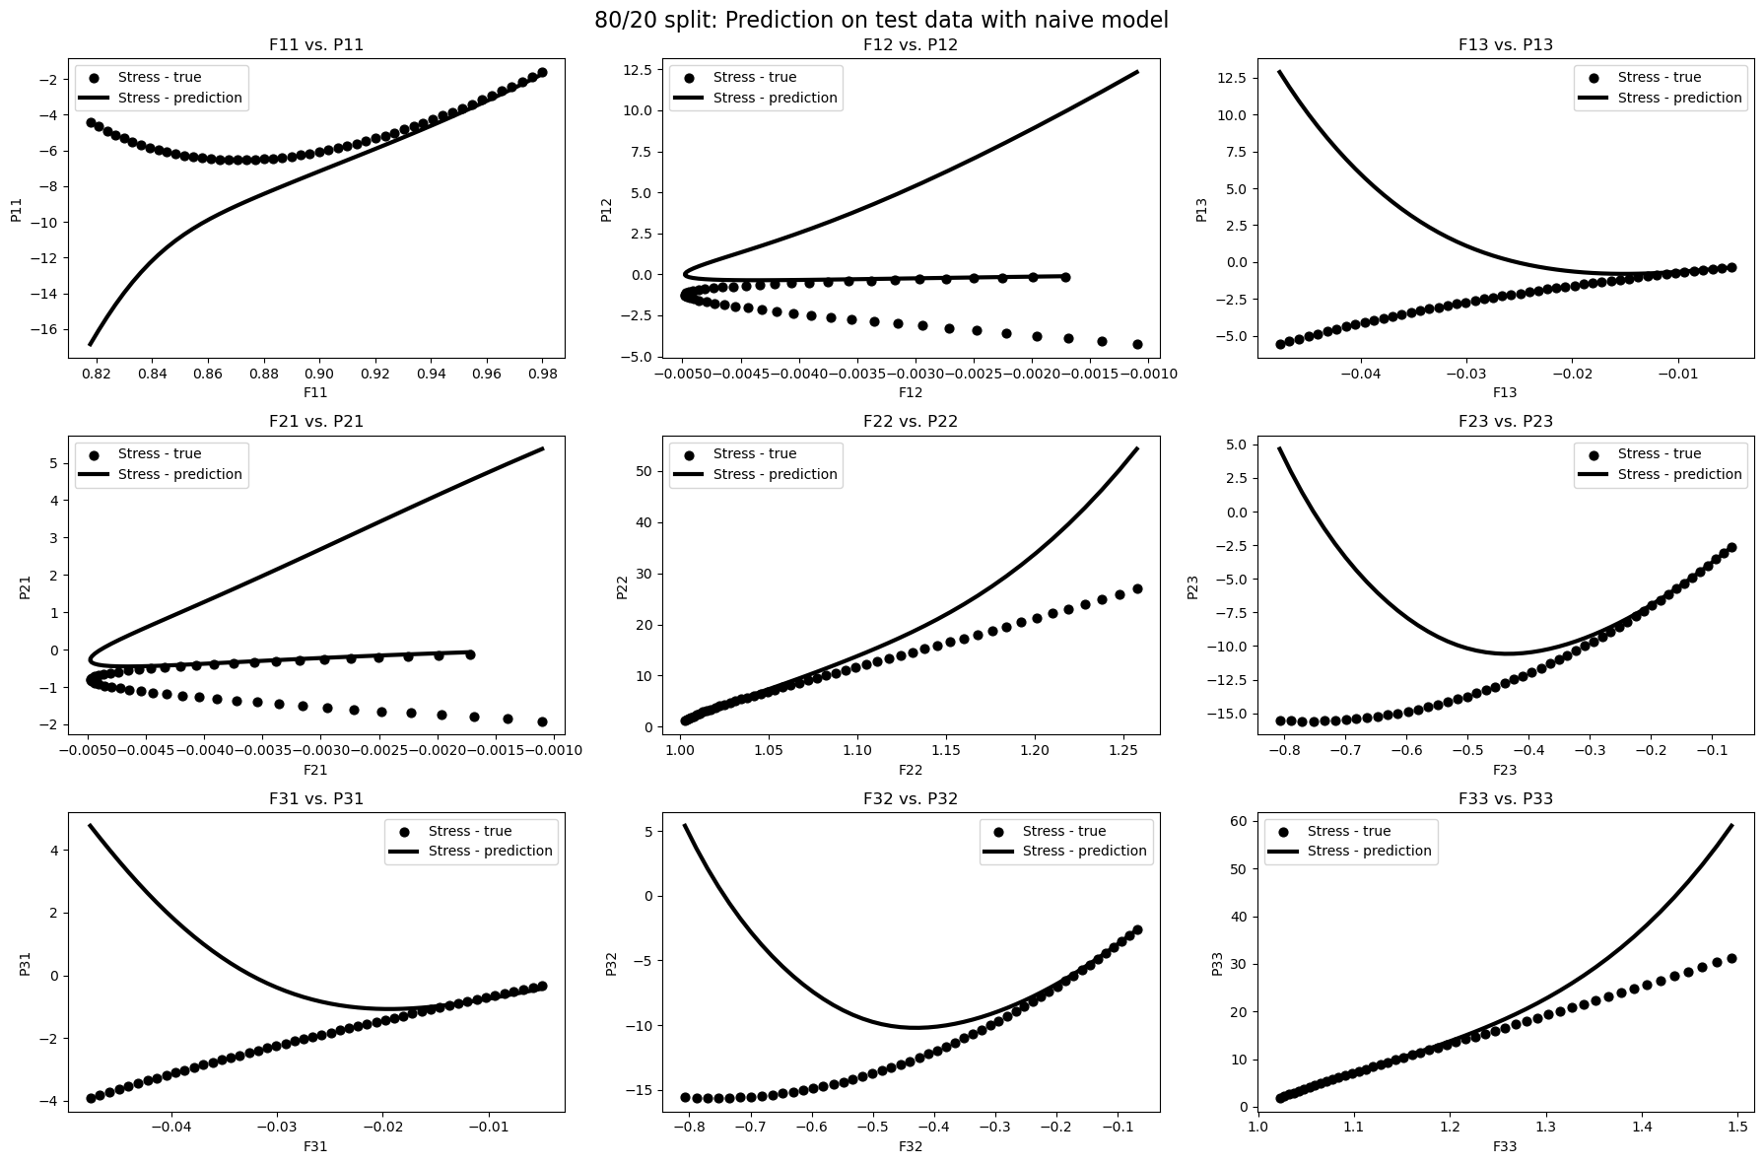
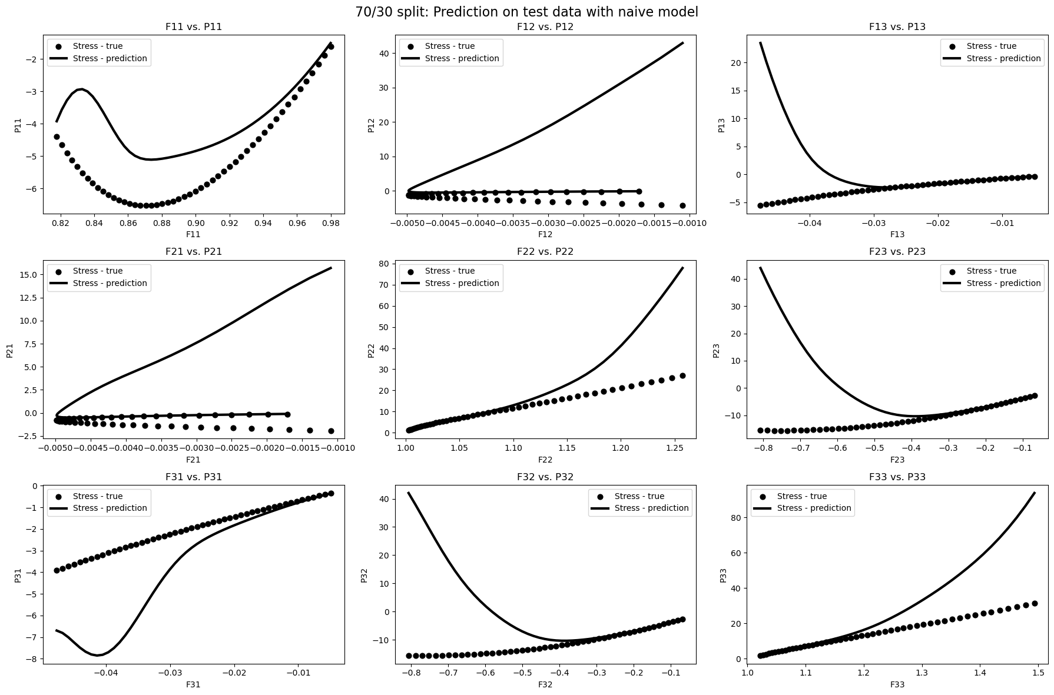
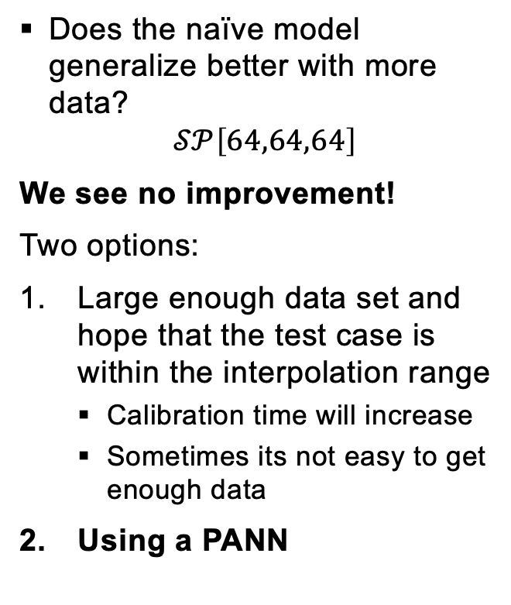
Concentric sampled deformation gradients – Generalization of NN’s
Does the naïve model generalize better with more data?
$$𝒮𝒫\left[64,64,64\right]$$
We see no improvement!
Two options:
Large enough data set and hope that the test case is within the interpolation range
Calibration time will increase
Sometimes its not easy to get enough data
Using a PANN

Slide 15
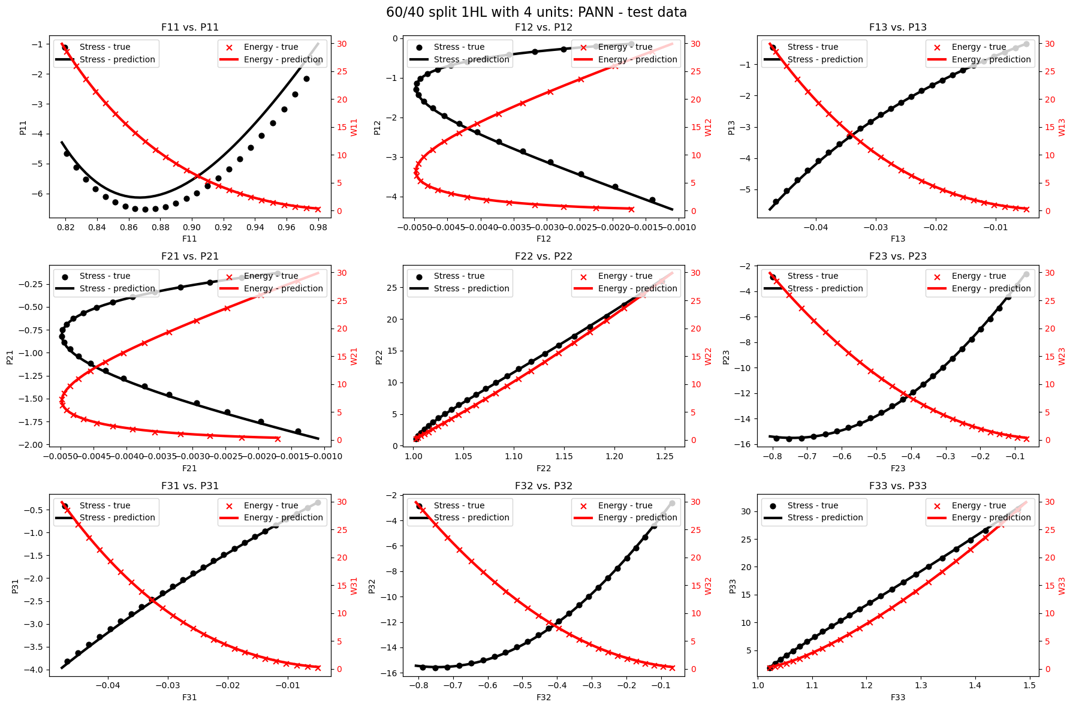
Concentric sampled deformation gradients – Generalization of NN’s
Using a PANN
Excellent generalization behavior already for 60/40 split
Very small NN
The more prior knowledge of physics we put into our model the larger the inductive bias and the less data we need for intra- and extrapolation

Slide 16
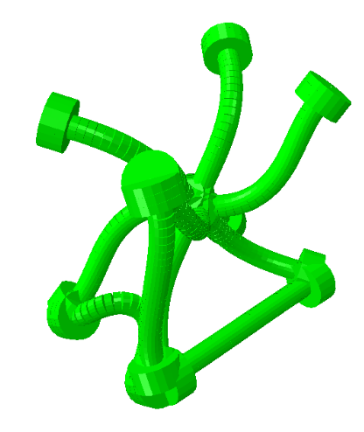
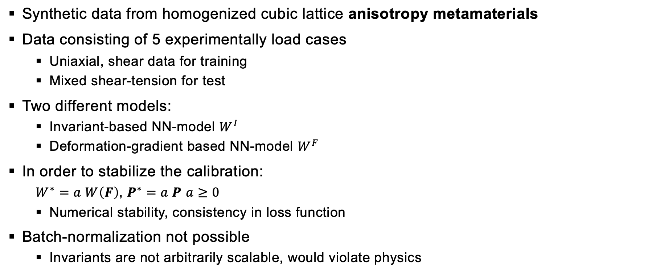
Homogenized cubic lattice metamaterials – Approximation of mathematical conditions
Synthetic data from homogenized cubic lattice anisotropy metamaterials
Data consisting of 5 experimentally load cases
Uniaxial, shear data for training
Mixed shear-tension for test
Two different models:
Invariant-based NN-model $W^{I}$
Deformation-gradient based NN-model $W^{F}$
In order to stabilize the calibration:
$W^{∗}=a W\left(F\right)$, $P^{∗}=a P$ $a≥0$
Numerical stability, consistency in loss function
Batch-normalization not possible
Invariants are not arbitrarily scalable, would violate physics
[2]
[2] https://doi.org/10.1016/j.jmps.2021.104703

Slide 17
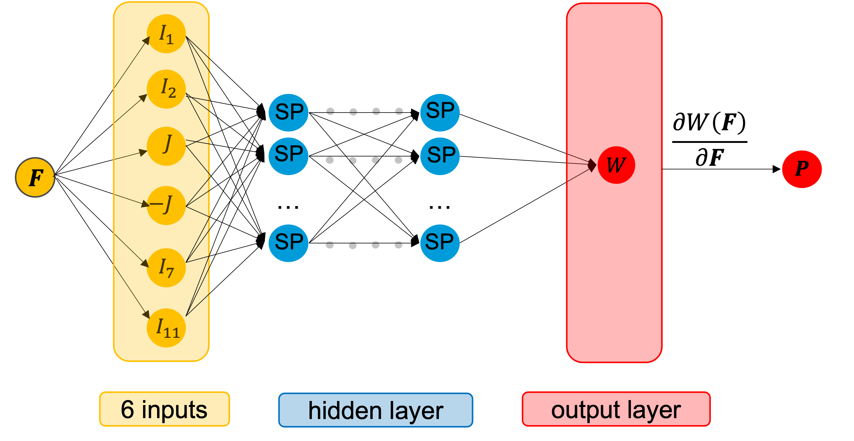
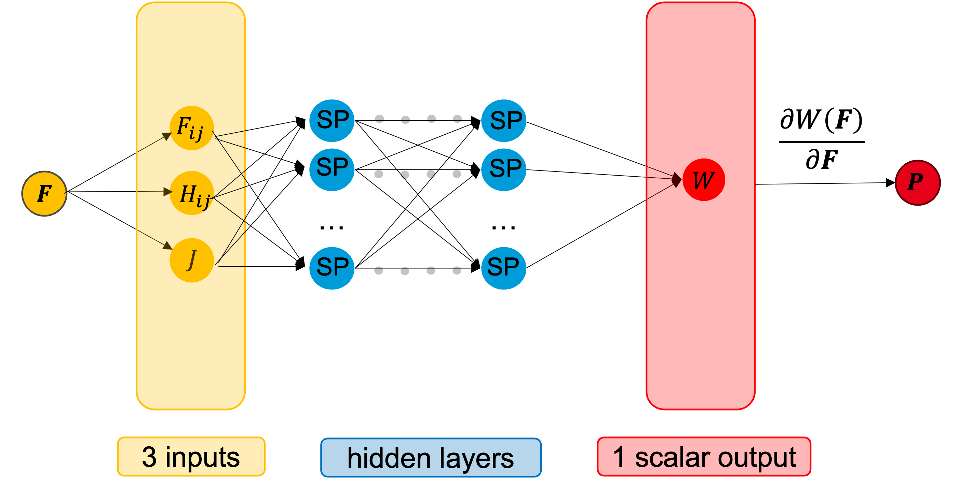
Homogenized cubic lattice metamaterials – models
Objectivity, material symmetry, thermodynamic consistency, polyconvex (ICNN)
Invariant-based PANN
thermodynamic consistency
Objectivity and material symmetry are not fulfilled
Polyconvex (ICNN)
Deformation gradient
based model

Slide 18
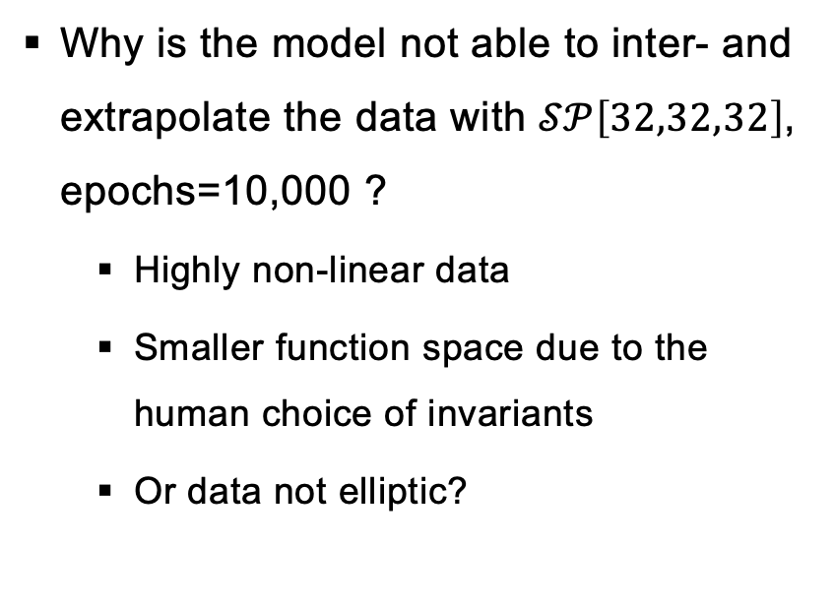
Homogenized cubic lattice metamaterials – Invariant-based model
Why is the model not able to inter- and extrapolate the data with $𝒮𝒫\left[32,32,32\right]$, epochs=10,000 ?
Highly non-linear data
Smaller function space due to the human choice of invariants
Or data not elliptic?

Slide 19
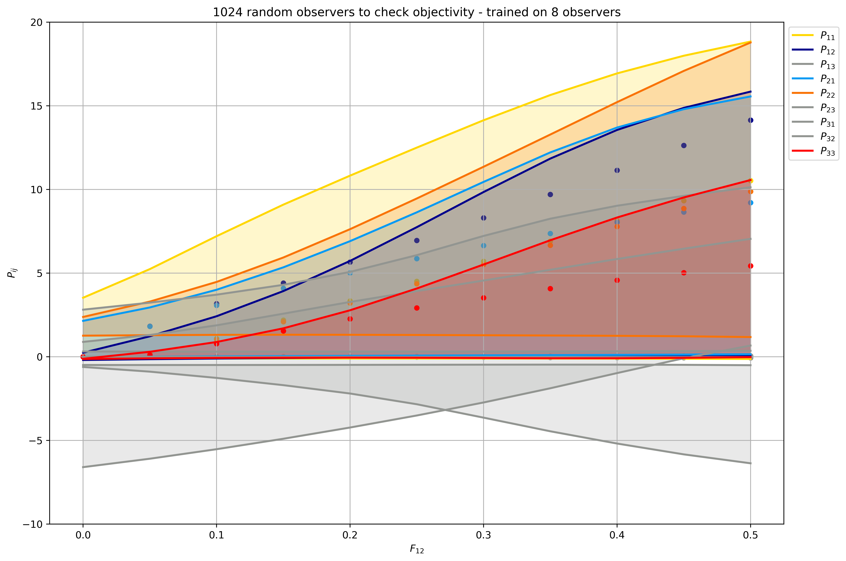
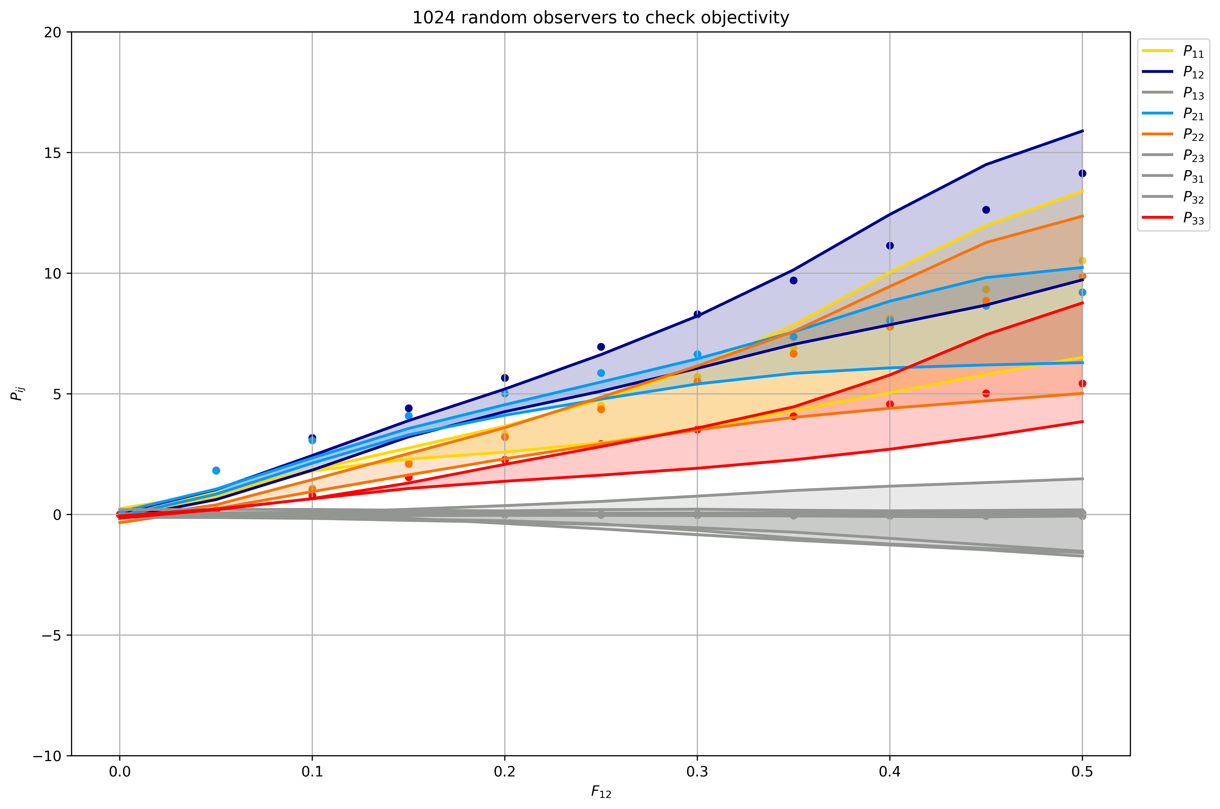
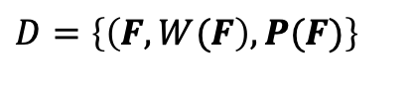
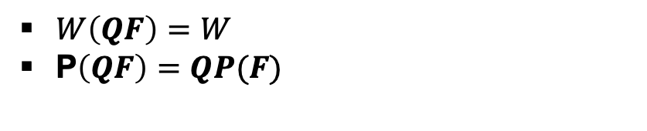
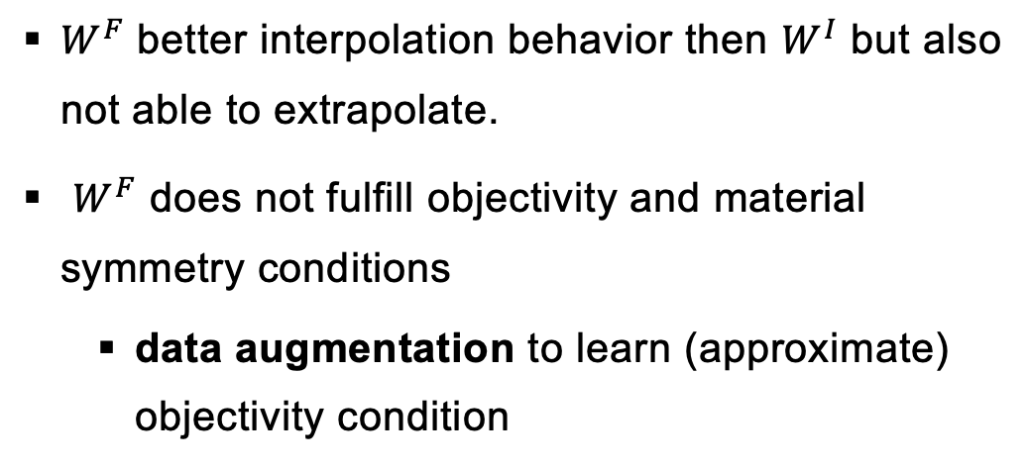
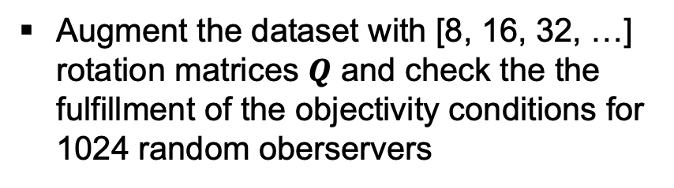
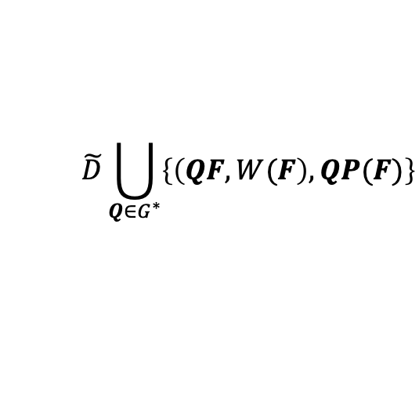
Homogenized cubic lattice metamaterials – Deformation gradient-based model
$W^{F}$ better interpolation behavior then $W^{I}$ but also not able to extrapolate.
$W^{F}$ does not fulfill objectivity and material symmetry conditions
data augmentation to learn (approximate) objectivity condition
$$\tilde{D}\bigcup_{Q∈G^{∗}}{\left\{\left(QF, W(F\right), QP(F)\right\}}$$
$D=\left\{\left(F, W(F\right), P(F)\right\}$
Augment the dataset with [8, 16, 32, …] rotation matrices $Q$ and check the the fulfillment of the objectivity conditions for 1024 random oberservers
$W\left(QF\right)=W$
P$\left(QF\right)=QP(F)$
Pros:
No “extra” data
Physics-aware
Cons:
Training time
Weak sense, not exactly fulfilled

Slide 20





Homogenized cubic lattice metamaterials – Deformation gradient-based model
$W^{F}$ better interpolation behavior then $W^{I}$ but also not able to extrapolate.
$W^{F}$ does not fulfill objectivity and material symmetry conditions
data augmentation to learn (approximate) objectivity condition
$$\tilde{D}\bigcup_{Q∈G^{∗}}{\left\{\left(QF, W(F\right), QP(F)\right\}}$$
$D=\left\{\left(F, W(F\right), P(F)\right\}$
Augment the dataset with [8, 16, 32, …] rotation matrices $Q$ and check the the fulfillment of the objectivity conditions for 1024 random oberservers
$W\left(QF\right)=W(F)$
P$\left(QF\right)=QP\left(F\right)$
Pros:
No “extra” data
Physics-aware
Cons:
Training time
Weak sense, not exactly fulfilled

Slide 21
Thank you for your attention!

Slide 22
Constitutive conditions for hyperelasticity models

Slide 23
Constitutive conditions for hyperelasticity models
Not considered in this tutorial!

Slide 24








Neural network model – A naïve approach
$$C_{11}$$
$$C_{12}$$
SP
SP
$$C_{13}$$
SP
SP
$$C$$
$$P$$
$$C_{22}$$
…
…
SP
SP
$$C_{23}$$
$$C_{33}$$
6 inputs
hidden layer
output layer

Slide 25










Invariant-based model – Model for cubic anisotropy metamaterial
$$I_{1}$$
$$I_{2}$$
SP
SP
$$\frac{∂W\left(F\right)}{∂F}$$
$$J$$
SP
SP
$$F$$
$$W$$
$$P$$
$$−J$$
…
…
SP
SP
$$I_{7}$$
$$I_{11}$$
6 inputs
hidden layer
output layer

Slide 26










Physics-augmented neural network model (PANN)
$W$ expressed in terms of invariants of $C= F^{T}F$
$$W\left(F\right)≡W\left(C\right)≡W\left(I_{1},J,I_{3}, I_{4},{ I}_{5}\right)$$
$I_{1}=tr C$, $J=\det{F}$, $I_{4}=tr (CG_{ti})$, $I_{5}=tr (CofCG_{ti})$
$$I_{1}$$
$$J$$
SP
SP
$$\frac{∂W\left(F\right)}{∂F}$$
SP
SP
$$W$$
$$P$$
$$F$$
$$−J$$
…
…
$$I_{4}$$
SP
SP
$$I_{5}$$
5 inputs
hidden layers
1 scalar output

Slide 27







Deformation-gradient based neural network
$$F_{ij}$$
SP
SP
$$\frac{∂W\left(F\right)}{∂F}$$
SP
SP
$$W$$
$$P$$
$$F$$
$$H_{ij}$$
…
…
$$J$$
SP
SP
3 inputs
hidden layers
1 scalar output

